Slide 1
Pricing Derivatives with Barriers in a Stochastic Interest Rate Environment
指導教授:戴天時
學 生:倪健翔

Slide 2
Introduction
The standard Black and Scholes frameworks is the starting point of options.
Risk-free interest rate is assumed constant.
For short term can be considered reasonable.
The exotic barrier option of stochastic interest rate is a difficult problem.
It is usually solved by Monte-Carlo simulations or partial differential equations.

Slide 3
Our framework
Use by Longstaff and Schwartz (1995) to value risky debt.
Collin-Dufresne and Goldstein (2001) generalized Fortet’s approximation to the case of two dimenstional Markovian processes.
We use their extension to price exotic barrier options.

Slide 4
Barrier Option in a Vasicek Model
The underlying asset price follow a geometric Brownian motion.
The interest rate model is a Vasicek , in particular the instantaneous interest rate r enjoys the Markovian property.

Slide 5
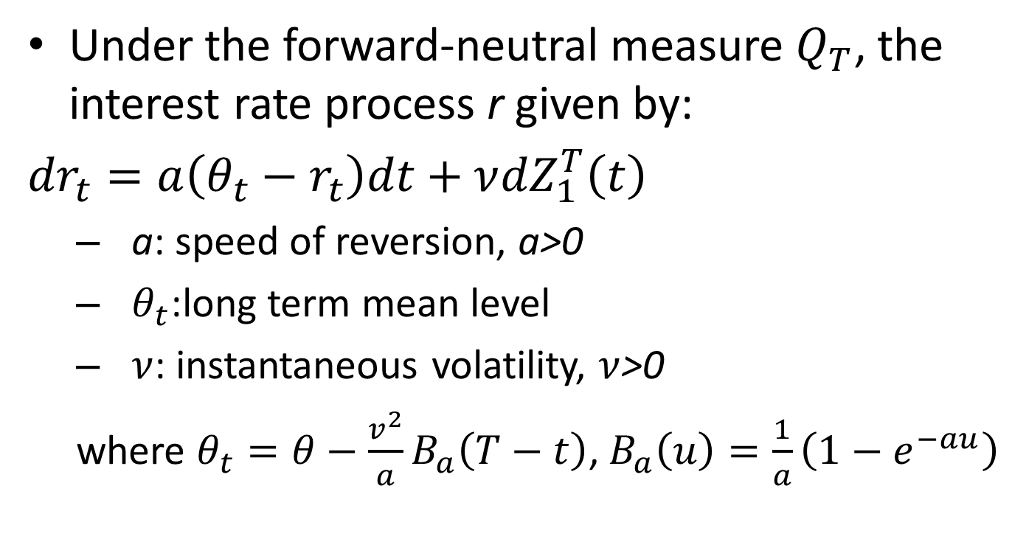
Vasicek Model
Under the forward-neutral measure $Q_{T}$, the interest rate process r given by:
${dr}_{t}=a\left(θ_{t}−r_{t}\right)dt+ν{dZ}_{1}^{T}\left(t\right)$
a: speed of reversion, a>0
$θ_{t}$:long term mean level
$ν$: instantaneous volatility, $ν$>0
where $θ_{t}=θ−\frac{v^{2}}{a}B_{a}\left(T−t\right)$,${ B}_{a}\left(u\right)=\frac{1}{a}\left(1−e^{−au}\right)$

Slide 6
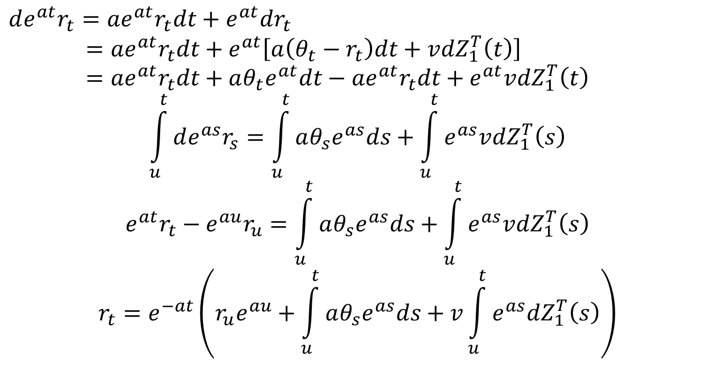
$$de^{at}r_{t}=ae^{at}r_{t}dt+e^{at}dr_{t}$$
$={ae}^{at}r_{t}dt+e^{at}\left[a\left(θ_{t}−r_{t}\right)dt+v{dZ}_{1}^{T}\left(t\right)\right]$
$={ae}^{at}r_{t}dt+aθ_{t}e^{at}dt−{ae}^{at}r_{t}dt+e^{at}v{dZ}_{1}^{T}\left(t\right)$
$$\int_{u}^{t}{de^{as}r_{s}=\int_{u}^{t}{aθ_{s}e^{as}ds+\int_{u}^{t}{e^{as}v{dZ}_{1}^{T}\left(s\right)}}}$$
$$e^{at}r_{t}−e^{au}r_{u}=\int_{u}^{t}{aθ_{s}e^{as}ds+\int_{u}^{t}{e^{as}v{dZ}_{1}^{T}\left(s\right)}}$$
$$r_{t}=e^{−at}\left(r_{u}e^{au}+\int_{u}^{t}{aθ_{s}e^{as}ds+v\int_{u}^{t}{e^{as}{dZ}_{1}^{T}\left(s\right)}}\right)$$

Slide 7
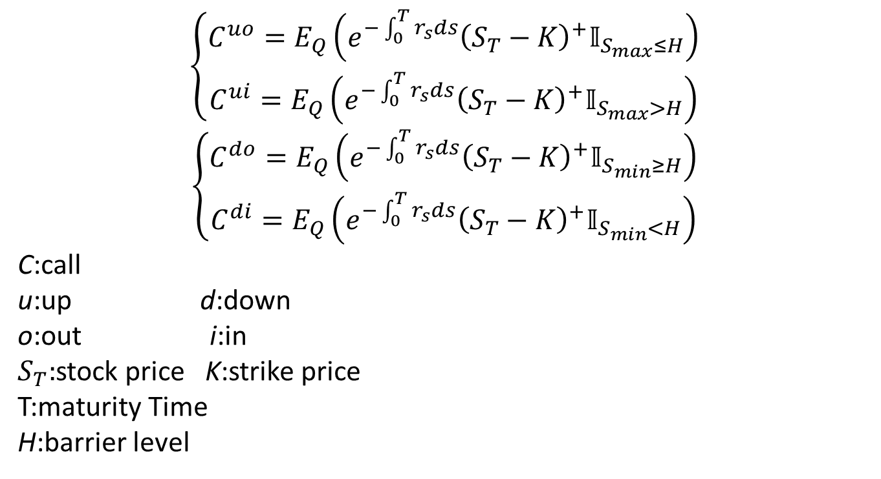
$$\left\{\begin{aligned}C^{uo}=E_{Q}\left(e^{−\int_{0}^{T}{r_{s}ds}}{\left(S_{T}−K\right)}^{+}𝕀_{S_{max}≤H}\right) \\ C^{ui}=E_{Q}\left(e^{−\int_{0}^{T}{r_{s}ds}}{\left(S_{T}−K\right)}^{+}𝕀_{S_{max}>H}\right)\end{aligned}\right.$$
$$\left\{\begin{aligned}C^{do}=E_{Q}\left(e^{−\int_{0}^{T}{r_{s}ds}}{\left(S_{T}−K\right)}^{+}𝕀_{S_{min}≥H}\right) \\ C^{di}=E_{Q}\left(e^{−\int_{0}^{T}{r_{s}ds}}{\left(S_{T}−K\right)}^{+}𝕀_{S_{min}<H}\right)\end{aligned}\right.$$
C:call
u:up d:down
o:out i:in
$S_{T}:$stock price K:strike price
T:maturity Time
H:barrier level

Slide 8
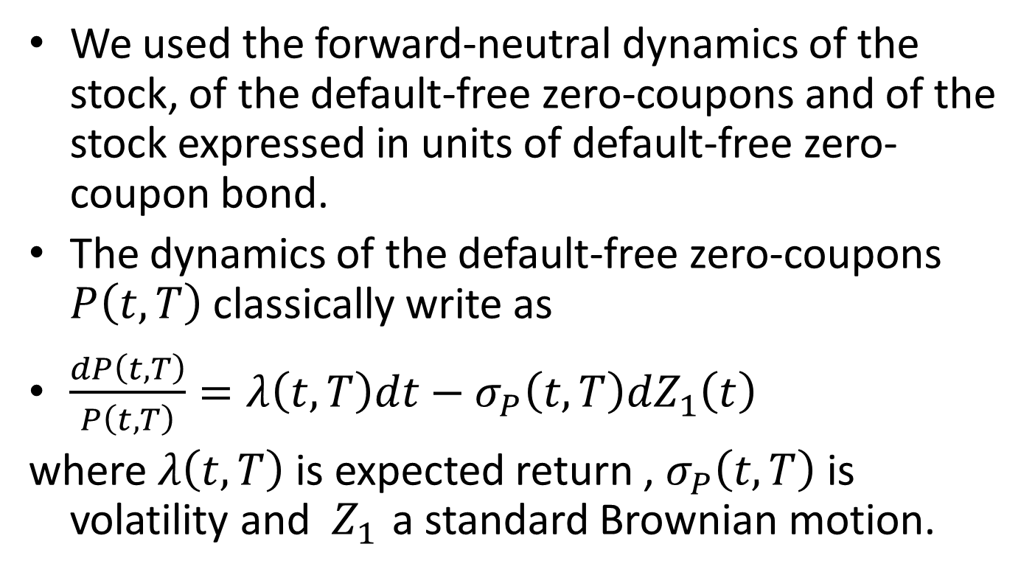
Pricing Framework
We used the forward-neutral dynamics of the stock, of the default-free zero-coupons and of the stock expressed in units of default-free zero-coupon bond.
The dynamics of the default-free zero-coupons $P\left(t,T\right)$ classically write as
$\frac{dP\left(t,T\right)}{P\left(t,T\right)}=λ\left(t,T\right)dt−σ_{P}\left(t,T\right){dZ}_{1}\left(t\right)$
where $λ\left(t,T\right)$is expected return , $σ_{P}\left(t,T\right)$ is volatility and $Z_{1}$ a standard Brownian motion.

Slide 9
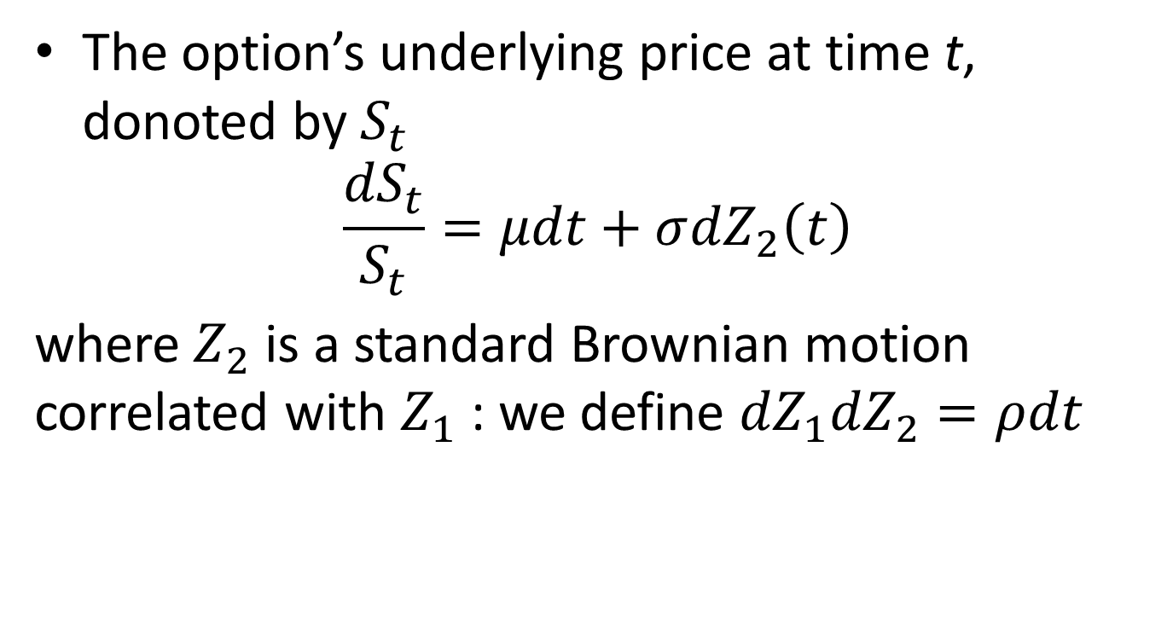
The option’s underlying price at time t, donoted by $S_{t}$
$$\frac{{dS}_{t}}{S_{t}}=μdt+σ{dZ}_{2}\left(t\right)$$
where $Z_{2}$ is a standard Brownian motion correlated with $Z_{1}$: we define ${dZ}_{1}{dZ}_{2}=ρdt$

Slide 10
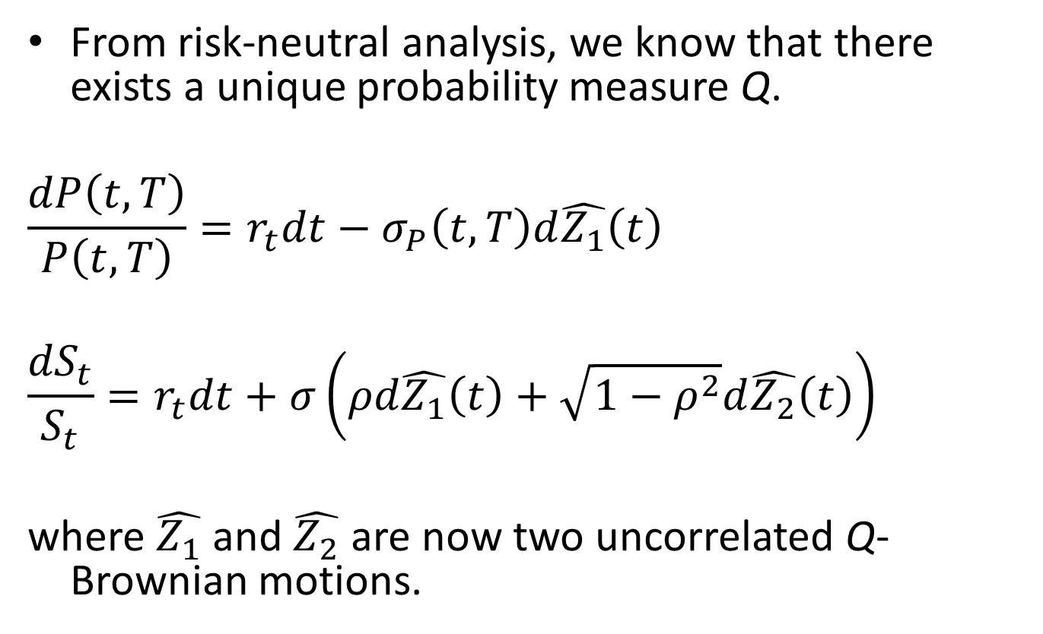
From risk-neutral analysis, we know that there exists a unique probability measure Q.
$$\frac{dP\left(t,T\right)}{P\left(t,T\right)}=r_{t}dt−σ_{P}\left(t,T\right)d\hat{Z_{1}}\left(t\right)$$
$$\frac{{dS}_{t}}{S_{t}}=r_{t}dt+σ\left(ρd\hat{Z_{1}}\left(t\right)+\sqrt{1−ρ^{2}}d\hat{Z_{2}}\left(t\right)\right)$$
where $\hat{Z_{1}}$ and $\hat{Z_{2}}$ are now two uncorrelated Q-Brownian motions.

Slide 11
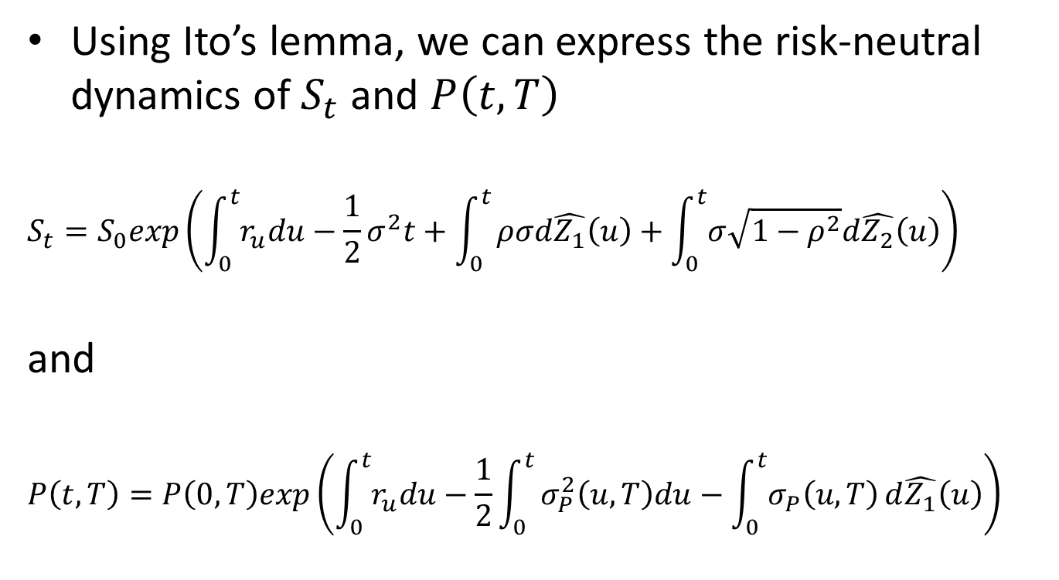
Using Ito’s lemma, we can express the risk-neutral dynamics of $S_{t}$ and $P\left(t,T\right)$
$$S_{t}=S_{0}exp\left(\int_{0}^{t}{r_{u}du}−\frac{1}{2}σ^{2}t+\int_{0}^{t}{ρσd\hat{Z_{1}}\left(u\right)+\int_{0}^{t}{σ\sqrt{1−ρ^{2}}d\hat{Z_{2}}\left(u\right)}}\right)$$
and
$$P\left(t,T\right)=P\left(0,T\right)exp\left(\int_{0}^{t}{r_{u}du}−\frac{1}{2}\int_{0}^{t}{σ_{P}^{2}\left(u,T\right)du−\int_{0}^{t}{σ_{P}\left(u,T\right)}d\hat{Z_{1}}\left(u\right)}\right)$$

Slide 12
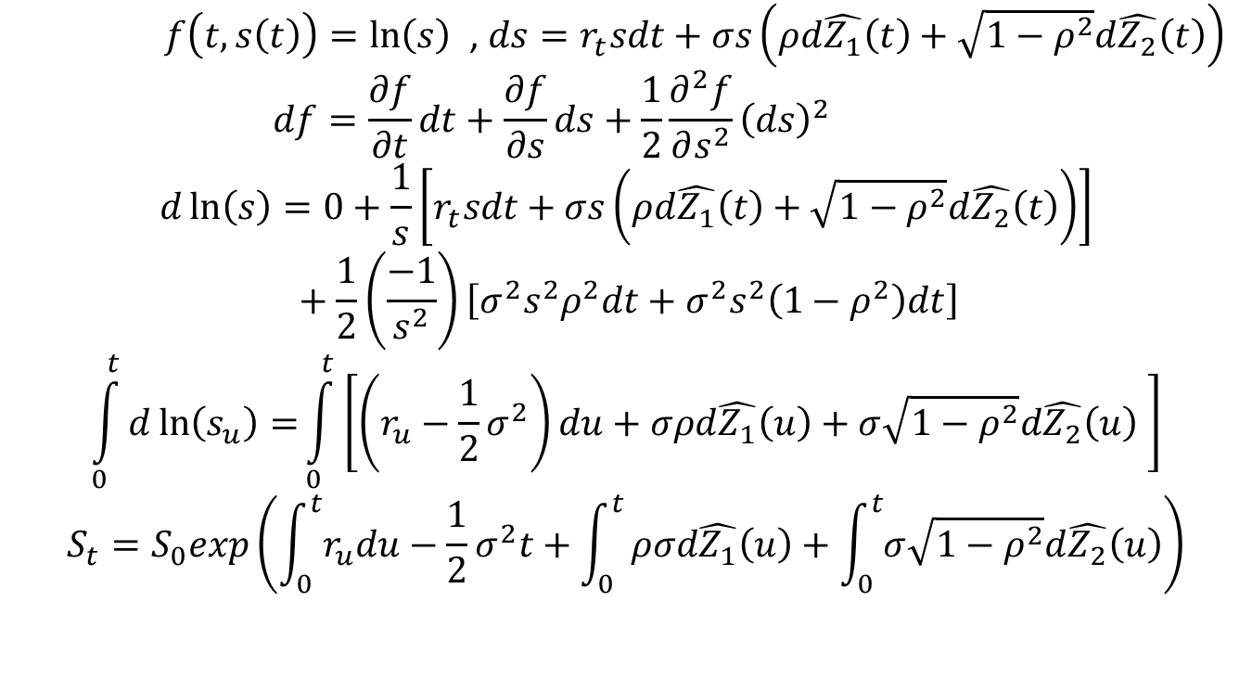
Ito’s lemma
$f\left(t,s\left(t\right)\right)=\ln\left(s\right)$ , $ds=r_{t}sdt+σs\left(ρd\hat{Z_{1}}\left(t\right)+\sqrt{1−ρ^{2}}d\hat{Z_{2}}\left(t\right)\right)$
$$df=\frac{∂f}{∂t}dt+\frac{∂f}{∂s}ds+\frac{1}{2}\frac{∂^{2}f}{∂s^{2}}{\left(ds\right)}^{2}$$
$$d\ln\left(s\right)=0+\frac{1}{s}\left[r_{t}sdt+σs\left(ρd\hat{Z_{1}}\left(t\right)+\sqrt{1−ρ^{2}}d\hat{Z_{2}}\left(t\right)\right)\right]+\frac{1}{2}\left(\frac{−1}{s^{2}}\right)\left[σ^{2}s^{2}ρ^{2}dt+σ^{2}s^{2}\left(1−ρ^{2}\right)dt\right]$$
$$\int_{0}^{t}{d\ln\left(s_{u}\right)=}\int_{0}^{t}{\left[\left(r_{u}−\frac{1}{2}σ^{2}\right)du+σρd\hat{Z_{1}}\left(u\right)+σ\sqrt{1−ρ^{2}}d\hat{Z_{2}}\left(u\right) \right]}$$
$$S_{t}=S_{0}exp\left(\int_{0}^{t}{r_{u}du}−\frac{1}{2}σ^{2}t+\int_{0}^{t}{ρσd\hat{Z_{1}}\left(u\right)+\int_{0}^{t}{σ\sqrt{1−ρ^{2}}d\hat{Z_{2}}\left(u\right)}}\right)$$

Slide 13
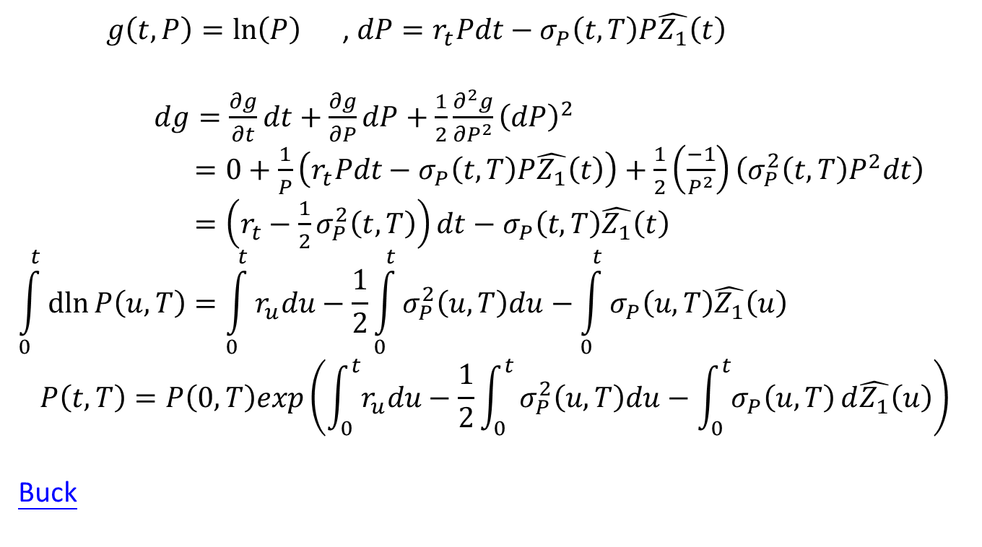
$g\left(t,P\right)=\ln\left(P\right)$ , ${dP=r}_{t}Pdt−σ_{P}\left(t,T\right)P\hat{Z_{1}}\left(t\right)$
$dg=\frac{∂g}{∂t}dt+\frac{∂g}{∂P}dP+\frac{1}{2}\frac{∂^{2}g}{∂P^{2}}{\left(dP\right)}^{2}$
$=0+\frac{1}{P}\left(r_{t}Pdt−σ_{P}\left(t,T\right)P\hat{Z_{1}}\left(t\right)\right)+\frac{1}{2}\left(\frac{−1}{P^{2}}\right)\left(σ_{P}^{2}\left(t,T\right)P^{2}dt\right)$
$=\left(r_{t}−\frac{1}{2}σ_{P}^{2}\left(t,T\right)\right)dt−σ_{P}\left(t,T\right)\hat{Z_{1}}\left(t\right)$
$$\int_{0}^{t}{\operatorname{dln}{P\left(u,T\right)=\int_{0}^{t}{r_{u}du}−\frac{1}{2}}}\int_{0}^{t}{σ_{P}^{2}\left(u,T\right)du}−\int_{0}^{t}{σ_{P}\left(u,T\right)\hat{Z_{1}}\left(u\right)}$$
$$P\left(t,T\right)=P\left(0,T\right)exp\left(\int_{0}^{t}{r_{u}du}−\frac{1}{2}\int_{0}^{t}{σ_{P}^{2}\left(u,T\right)du−\int_{0}^{t}{σ_{P}\left(u,T\right)}d\hat{Z_{1}}\left(u\right)}\right)$$
Buck

Slide 14
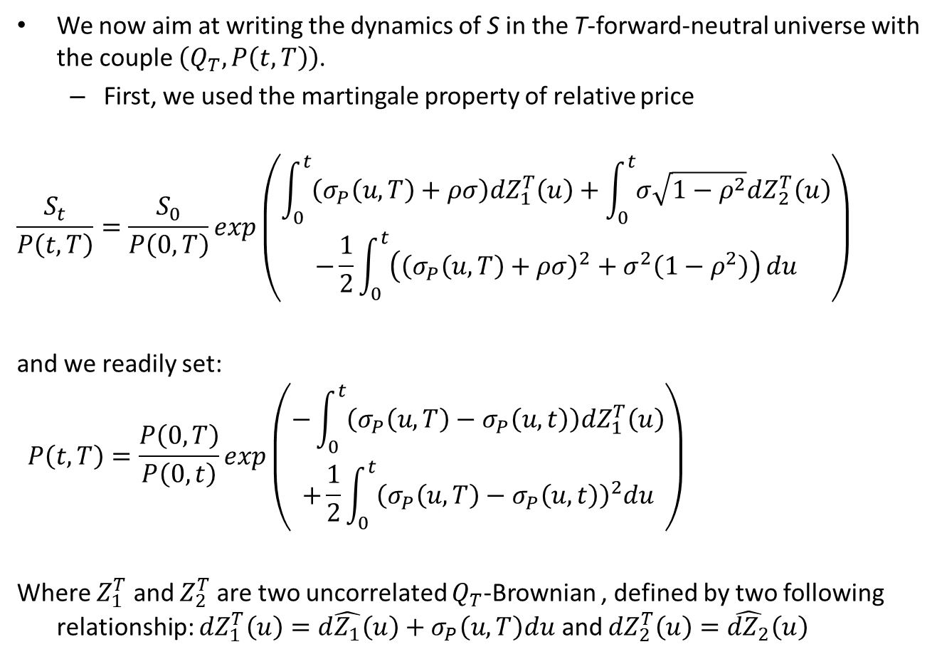
We now aim at writing the dynamics of S in the T-forward-neutral universe with the couple $\left(Q_{T},P\left(t,T\right)\right)$.
First, we used the martingale property of relative price
$$\frac{S_{t}}{P\left(t,T\right)}=\frac{S_{0}}{P\left(0,T\right)}exp\left(\begin{aligned}\int_{0}^{t}{\left(σ_{P}\left(u,T\right)+ρσ\right){dZ}_{1}^{T}\left(u\right)+\int_{0}^{t}{σ\sqrt{1−ρ^{2}}{dZ}_{2}^{T}\left(u\right)}} \\ −\frac{1}{2}\int_{0}^{t}{\left({\left(σ_{P}\left(u,T\right)+ρσ\right)}^{2}+σ^{2}\left(1−ρ^{2}\right)\right)}du\end{aligned}\right)$$
and we readily set:
$$P\left(t,T\right)=\frac{P\left(0,T\right)}{P\left(0,t\right)}exp\left(\begin{aligned}−\int_{0}^{t}{\left(σ_{P}\left(u,T\right)−σ_{P}\left(u,t\right)\right){dZ}_{1}^{T}\left(u\right)} \\ +\frac{1}{2}\int_{0}^{t}{{\left(σ_{P}\left(u,T\right)−σ_{P}\left(u,t\right)\right)}^{2}du}\end{aligned}\right)$$
Where $Z_{1}^{T}$ and $Z_{2}^{T}$ are two uncorrelated $Q_{T}$-Brownian , defined by two following relationship: ${dZ}_{1}^{T}\left(u\right)=d\hat{Z_{1}}\left(u\right)+σ_{P}\left(u,T\right)du$ and ${dZ}_{2}^{T}\left(u\right)=\hat{{dZ}_{2}}\left(u\right)$

Slide 15
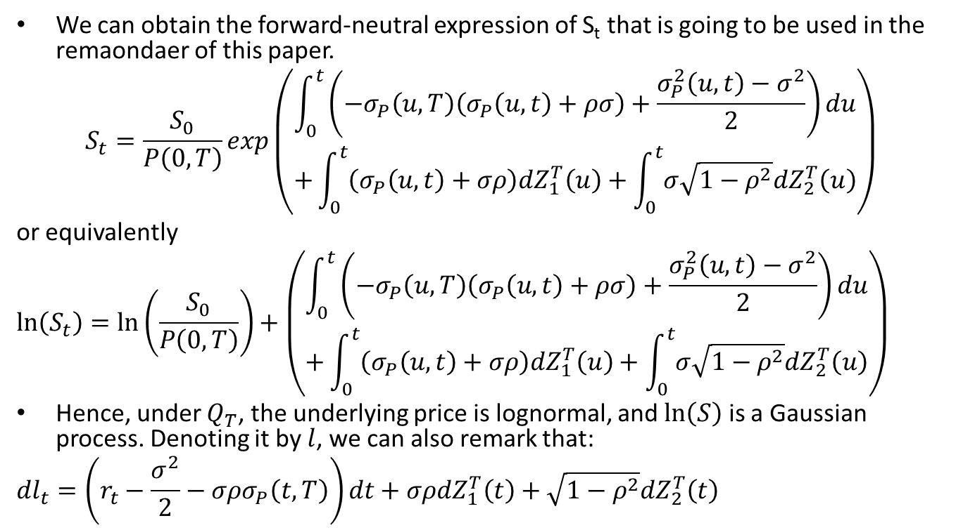
We can obtain the forward-neutral expression of S_{t} that is going to be used in the remaondaer of this paper.
$$S_{t}{=\frac{S_{0}}{P\left(0,T\right)}exp\left(\begin{aligned}\int_{0}^{t}{\left(−σ_{P}\left(u,T\right)\left(σ_{P}\left(u,t\right)+ρσ\right)+\frac{σ_{P}^{2}\left(u,t\right)−σ^{2}}{2}\right)du} \\ +\int_{0}^{t}{\left(σ_{P}\left(u,t\right)+σρ\right){dZ}_{1}^{T}\left(u\right)+\int_{0}^{t}{σ\sqrt{1−ρ^{2}}{dZ}_{2}^{T}\left(u\right)}}\end{aligned}\right)}$$
or equivalently
$$\ln\left(S_{t}\right)=\ln\left(\frac{S_{0}}{P\left(0,T\right)}\right)+\left(\begin{aligned}\int_{0}^{t}{\left(−σ_{P}\left(u,T\right)\left(σ_{P}\left(u,t\right)+ρσ\right)+\frac{σ_{P}^{2}\left(u,t\right)−σ^{2}}{2}\right)du} \\ +\int_{0}^{t}{\left(σ_{P}\left(u,t\right)+σρ\right){dZ}_{1}^{T}\left(u\right)+\int_{0}^{t}{σ\sqrt{1−ρ^{2}}{dZ}_{2}^{T}\left(u\right)}}\end{aligned}\right)$$
Hence, under $Q_{T}$, the underlying price is lognormal, and $\ln\left(S\right)$ is a Gaussian process. Denoting it by $l$, we can also remark that:
$${dl}_{t}=\left(r_{t}−\frac{σ^{2}}{2}−σρσ_{P}\left(t,T\right)\right)dt+σρ{dZ}_{1}^{T}\left(t\right)+\sqrt{1−ρ^{2}}{dZ}_{2}^{T}\left(t\right)$$

Slide 16
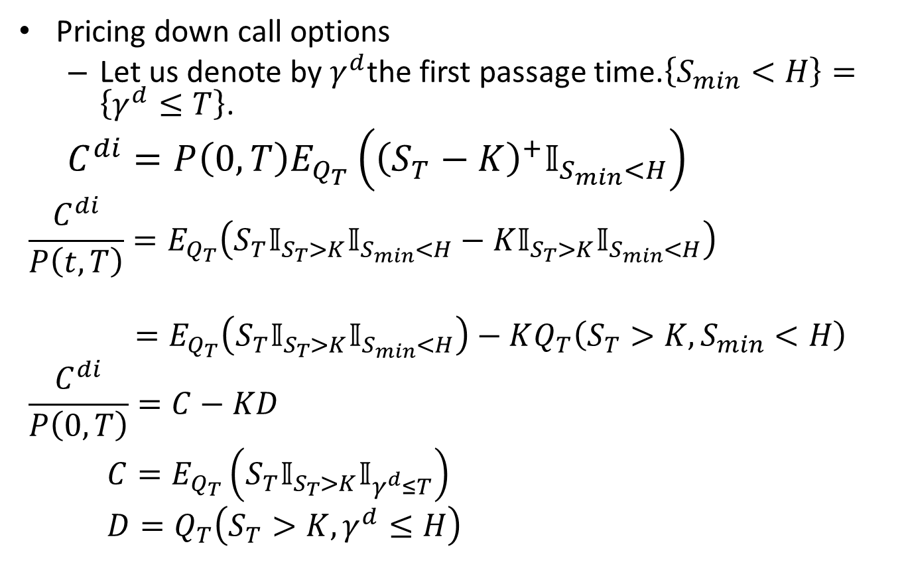
Semi-Closed Form formulas
Pricing down call options
Let us denote by $γ^{d}$the first passage time.$\left\{S_{min}<H\right\}=\left\{γ^{d}≤T\right\}$.
$$C^{di}=P\left(0,T\right)E_{Q_{T}}\left({\left(S_{T}−K\right)}^{+}𝕀_{S_{min}<H}\right)$$
$$\frac{C^{di}}{P\left(t,T\right)}=E_{Q_{T}}\left(S_{T}𝕀_{S_{T}>K}𝕀_{S_{min}<H}−K𝕀_{S_{T}>K}𝕀_{S_{min}<H}\right)$$
$=E_{Q_{T}}\left(S_{T}𝕀_{S_{T}>K}𝕀_{S_{min}<H}\right)−KQ_{T}\left(S_{T}>K,S_{min}<H\right)$
$$\frac{C^{di}}{P\left(0,T\right)}=C−KD$$
$$C=E_{Q_{T}}\left(S_{T}𝕀_{S_{T}>K}𝕀_{γ^{d}≤T}\right)$$
$$D=Q_{T}\left(S_{T}>K,γ^{d}≤H\right)$$

Slide 17
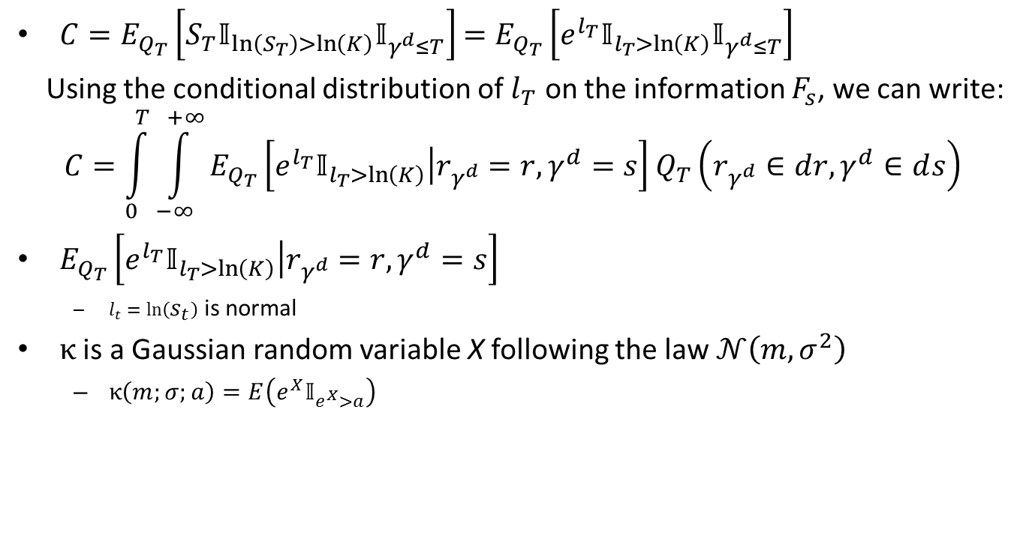
$C=E_{Q_{T}}\left[S_{T}𝕀_{\ln\left(S_{T}\right)>\ln\left(K\right)}𝕀_{γ^{d}≤T}\right]$ $=E_{Q_{T}}\left[e^{l_{T}}𝕀_{l_{T}>\ln\left(K\right)}𝕀_{γ^{d}≤T}\right]$
Using the conditional distribution of $l_{T}$ on the information $F_{s}$, we can write:
$$C=\int_{0}^{T}{\int_{−∞}^{+∞}{E_{Q_{T}}\left[\left.e^{l_{T}}𝕀_{l_{T}>\ln\left(K\right)}\right|r_{γ^{d}}=r,γ^{d}=s\right]Q_{T}\left(r_{γ^{d}}∈ⅆr,γ^{d}∈ⅆs\right)}}$$
$E_{Q_{T}}\left[\left.e^{l_{T}}𝕀_{l_{T}>\ln\left(K\right)}\right|r_{γ^{d}}=r,γ^{d}=s\right]$
$l_{t}=\ln\left(s_{t}\right)$ is normal
$κ$ is a Gaussian random variable X following the law $𝒩\left(m,σ^{2}\right)$
$κ\left(m;σ;a\right)=E\left(e^{X}𝕀_{e^{X}>a}\right)$

Slide 18
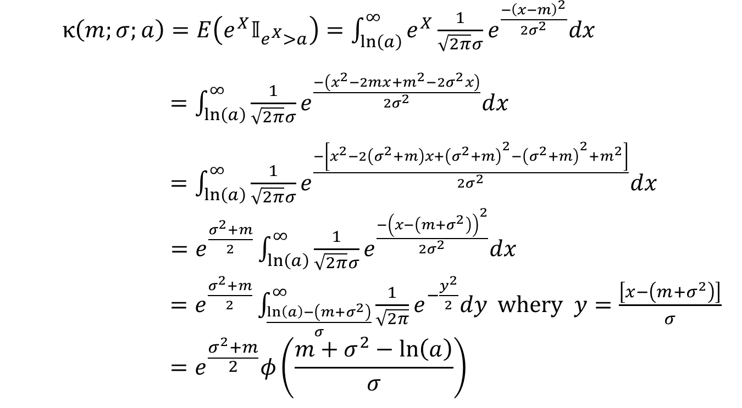
Kappa
$κ\left(m;σ;a\right)=E\left(e^{X}𝕀_{e^{X}>a}\right)=\int_{\ln\left(a\right)}^{∞}{e^{X}\frac{1}{\sqrt{2π}σ}}e^{\frac{−{\left(x−m\right)}^{2}}{{2σ}^{2}}}dx$
$=\int_{\ln\left(a\right)}^{∞}{\frac{1}{\sqrt{2π}σ}}e^{\frac{−\left(x^{2}−2mx+m^{2}−{2σ}^{2}x\right)}{{2σ}^{2}}}dx$
$=\int_{\ln\left(a\right)}^{∞}{\frac{1}{\sqrt{2π}σ}}e^{\frac{−\left[x^{2}−2\left(σ^{2}+m\right)x+{\left(σ^{2}+m\right)}^{2}−{\left(σ^{2}+m\right)}^{2}+m^{2}\right]}{{2σ}^{2}}}dx$
$=e^{\frac{σ^{2}+m}{2}}\int_{\ln\left(a\right)}^{∞}{\frac{1}{\sqrt{2π}σ}}e^{\frac{−{\left(x−\left(m+σ^{2}\right)\right)}^{2}}{{2σ}^{2}}}dx$
$=e^{\frac{σ^{2}+m}{2}}\int_{\frac{\ln\left(a\right)−\left(m+σ^{2}\right)}{σ}}^{∞}{\frac{1}{\sqrt{2π}}e^{−\frac{y^{2}}{2}}dy}$ whery $y=\frac{\left[x−\left(m+σ^{2}\right)\right]}{σ}$
$$=e^{\frac{σ^{2}+m}{2}}φ\left(\frac{m+σ^{2}−\ln\left(a\right)}{σ}\right)$$

Slide 19
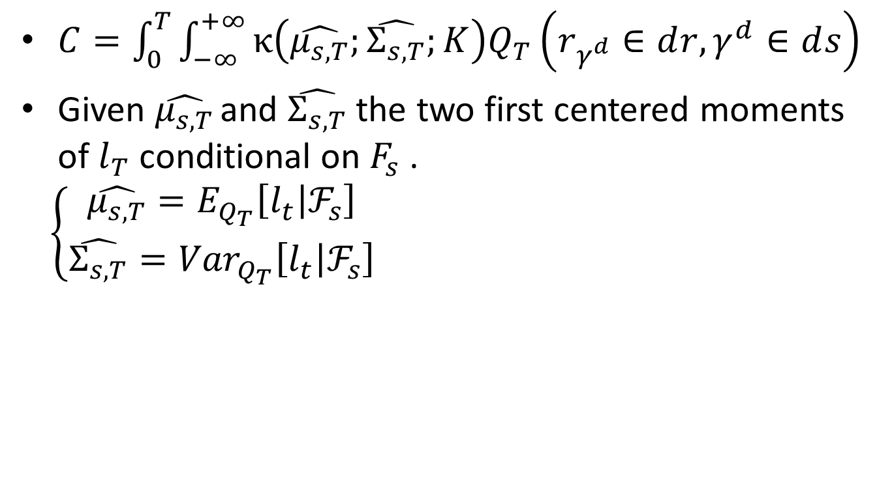
$C=\int_{0}^{T}{\int_{−∞}^{+∞}{κ\left(\hat{μ_{s,T}};\hat{Σ_{s,T}};K\right)Q_{T}\left(r_{γ^{d}}∈ⅆr,γ^{d}∈ⅆs\right)}}$
Given $\hat{μ_{s,T}}$ and $\hat{Σ_{s,T}}$ the two first centered moments of $l_{T}$ conditional on $F_{s}$ .
$$\left\{\begin{aligned}\hat{μ_{s,T}}=E_{Q_{T}}\left[l_{t}\left|ℱ_{s}\right.\right] \\ \hat{Σ_{s,T}}={Var}_{Q_{T}}\left[l_{t}\left|ℱ_{s}\right.\right]\end{aligned}\right.$$

Slide 20
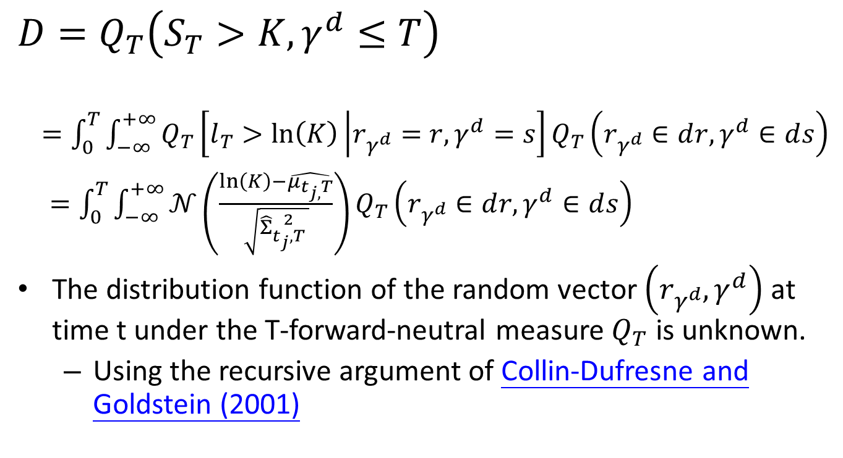
$$D=Q_{T}\left(S_{T}>K,γ^{d}≤T\right)$$
$=\int_{0}^{T}{\int_{−∞}^{+∞}{Q_{T}\left[l_{T}>\ln\left(K\right)\left|r_{γ^{d}}=r,γ^{d}=s\right.\right]}}Q_{T}\left(r_{γ^{d}}∈ⅆr,γ^{d}∈ⅆs\right)$
$=\int_{0}^{T}{\int_{−∞}^{+∞}{𝒩\left(\frac{\ln\left(K\right)−\hat{μ_{t_{j,}T}}}{\sqrt{\hat{Σ}{2 \atop t_{j},T} }}\right)}}Q_{T}\left(r_{γ^{d}}∈ⅆr,γ^{d}∈ⅆs\right)$
The distribution function of the random vector $\left(r_{γ^{d}},γ^{d}\right)$ at time t under the T-forward-neutral measure $Q_{T}$ is unknown.
Using the recursive argument of Collin-Dufresne and Goldstein (2001)

Slide 21
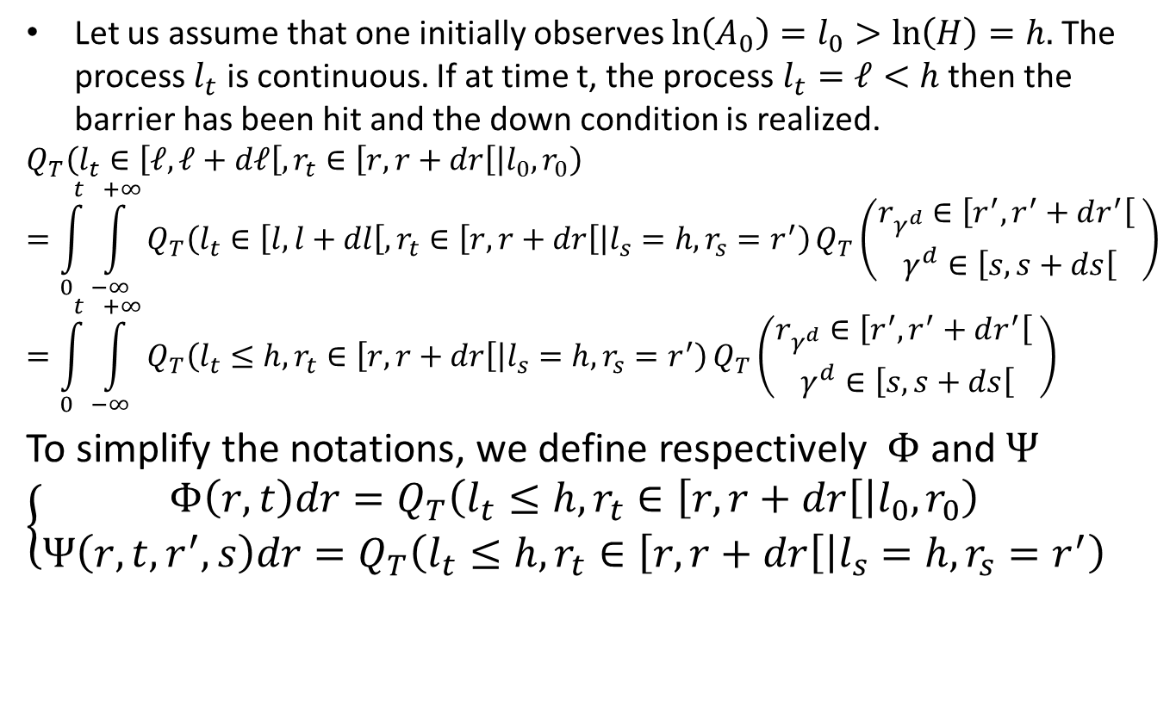
The extended Fortet Method
Let us assume that one initially observes $\ln\left(A_{0}\right)=l_{0}>\ln\left(H\right)=h.$ The process $l_{t}$ is continuous. If at time t, the process $l_{t}=ℓ<h$ then the barrier has been hit and the down condition is realized.
$$Q_{T}\left(l_{t}∈\left[ℓ,ℓ+dℓ\right[,r_{t}∈\left[r,r+dr\right[\left|l_{0},r_{0}\right.\right)$$
$$=\int_{0}^{t}{\int_{−∞}^{+∞}{Q_{T}\left(l_{t}∈\left[l,l+dl\right[,r_{t}∈\left[r,r+dr\right[\left|l_{s}=h,r_{s}=r^{′}\right.\right)}}Q_{T}\left(\begin{aligned}r_{γ^{d}}∈\left[r^{′},r^{′}+dr^{′}\right[ \\ γ^{d}∈\left[s,s+ds\right[\end{aligned}\right)$$
$$=\int_{0}^{t}{\int_{−∞}^{+∞}{Q_{T}\left(l_{t}≤h,r_{t}∈\left[r,r+dr\right[\left|l_{s}=h,r_{s}=r^{′}\right.\right)}}Q_{T}\left(\begin{aligned}r_{γ^{d}}∈\left[r^{′},r^{′}+dr^{′}\right[ \\ γ^{d}∈\left[s,s+ds\right[\end{aligned}\right)$$
To simplify the notations, we define respectively $Φ$ and $Ψ$
$$\left\{\begin{aligned}Φ\left(r,t\right)dr=Q_{T}\left(l_{t}≤h, r_{t}∈\left[r,r+dr\right[\left|l_{0},r_{0}\right.\right) \\ Ψ\left(r,t,r^{′},s\right)dr=Q_{T}\left(l_{t}≤h,r_{t}∈\left[r,r+dr\right[\left|l_{s}=h,r_{s}=r^{′}\right.\right)\end{aligned}\right.$$

Slide 22
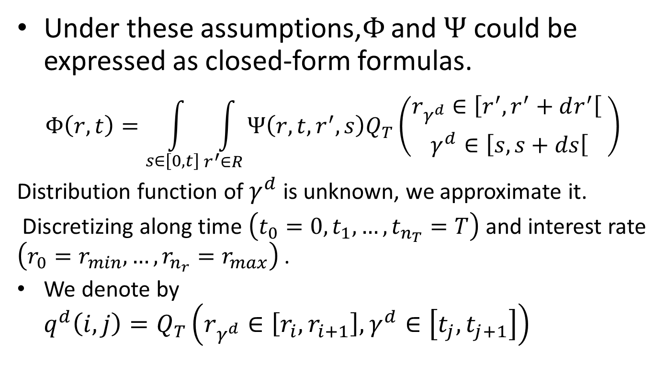
Under these assumptions,$Φ$ and $Ψ$ could be expressed as closed-form formulas.
$$Φ\left(r,t\right)=\int_{s∈\left[0,t\right]}{\int_{r^{′}∈R}{Ψ\left(r,t,r^{′},s\right)Q_{T}\left(\begin{aligned}r_{γ^{d}}∈\left[r^{′},r^{′}+dr^{′}\right[ \\ γ^{d}∈\left[s,s+ds\right[\end{aligned}\right)}}$$
Distribution function of $γ^{d}$ is unknown, we approximate it.
Discretizing along time $\left(t_{0}=0,t_{1},…,t_{n_{T}}=T\right)$ and interest rate $\left(r_{0}=r_{min},…,r_{n_{r}}=r_{max}\right)$ .
We denote by $q^{d}\left(i,j\right)=Q_{T}\left(r_{γ^{d}}∈\left[r_{i},r_{i+1}\right],γ^{d}∈\left[t_{j},t_{j+1}\right]\right)$

Slide 23
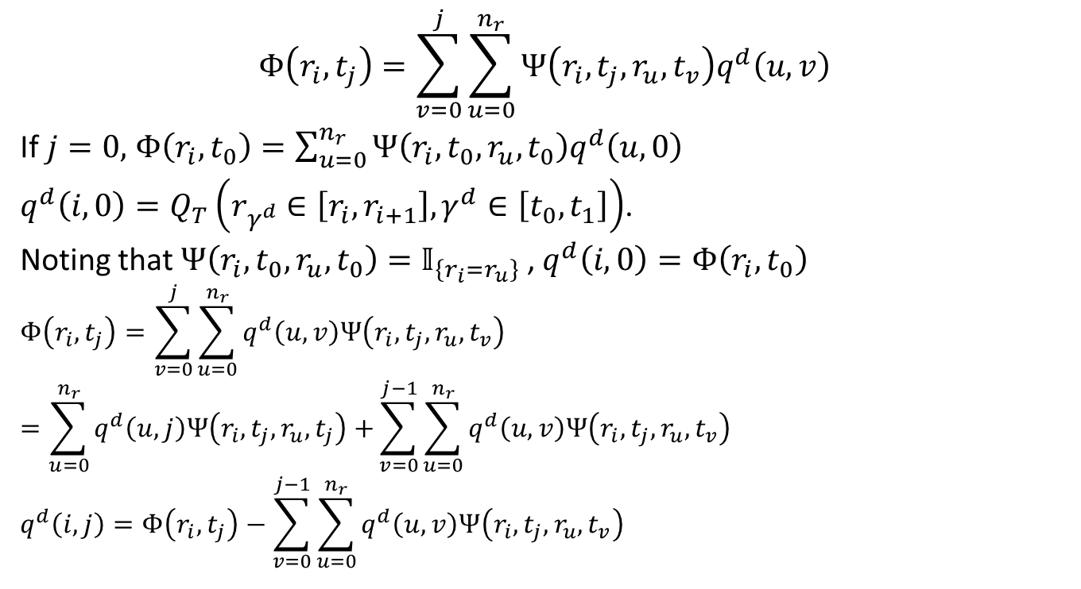
$$Φ\left(r_{i},t_{j}\right)=\sum_{v=0}^{j}{\sum_{u=0}^{n_{r}}{Ψ\left(r_{i},t_{j},r_{u},t_{v}\right)q^{d}\left(u,v\right)}}$$
If $j=0,$ $Φ\left(r_{i},t_{0}\right)=\sum_{u=0}^{n_{r}}{Ψ\left(r_{i},t_{0},r_{u},t_{0}\right)q^{d}\left(u,0\right)}$
$q^{d}\left(i,0\right)=Q_{T}\left(r_{γ^{d}}∈\left[r_{i},r_{i+1}\right],γ^{d}∈\left[t_{0},t_{1}\right]\right)$.
Noting that $Ψ\left(r_{i},t_{0},r_{u},t_{0}\right)=𝕀_{\left\{r_{i}=r_{u}\right\}}$ , $q^{d}\left(i,0\right)=Φ\left(r_{i},t_{0}\right)$
$$Φ\left(r_{i},t_{j}\right)=\sum_{v=0}^{j}{\sum_{u=0}^{n_{r}}{q^{d}\left(u,v\right)Ψ\left(r_{i},t_{j},r_{u},t_{v}\right)}}$$
$$=\sum_{u=0}^{n_{r}}{q^{d}\left(u,j\right)Ψ\left(r_{i},t_{j},r_{u},t_{j}\right)+}\sum_{v=0}^{j−1}{\sum_{u=0}^{n_{r}}{q^{d}\left(u,v\right)Ψ\left(r_{i},t_{j},r_{u},t_{v}\right)}}$$
$$q^{d}\left(i,j\right)=Φ\left(r_{i},t_{j}\right)−\sum_{v=0}^{j−1}{\sum_{u=0}^{n_{r}}{q^{d}\left(u,v\right)Ψ\left(r_{i},t_{j},r_{u},t_{v}\right)}}$$

Slide 24
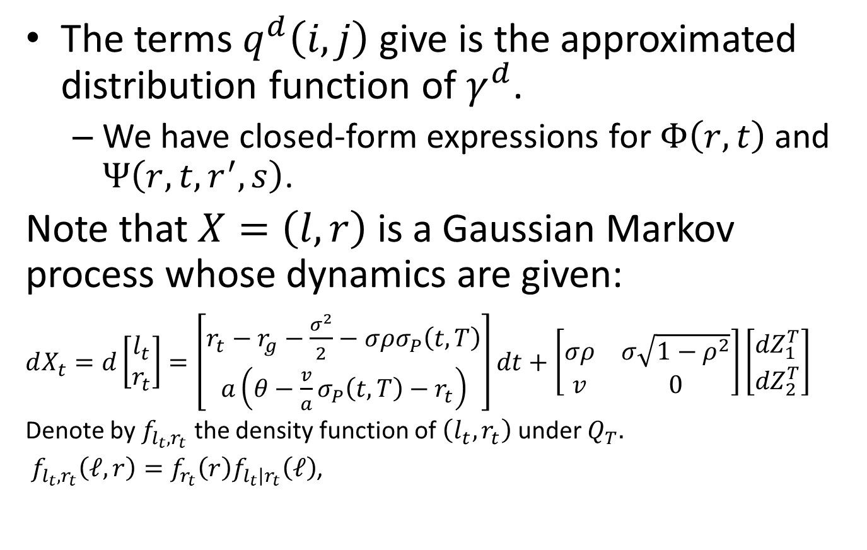
The terms $q^{d}\left(i,j\right)$ give is the approximated distribution function of $γ^{d}$.
We have closed-form expressions for $Φ\left(r,t\right)$ and $Ψ\left(r,t,r^{′},s\right)$.
Note that $X=\left(l,r\right)$ is a Gaussian Markov process whose dynamics are given:
$dX_{t}=d\left[\begin{matrix}l_{t} \\ r_{t}\end{matrix}\right]=\left[\begin{matrix}r_{t}−r_{g}−\frac{σ^{2}}{2}−σρσ_{P}\left(t,T\right) \\ a\left(θ−\frac{v}{a}σ_{P}\left(t,T\right)−r_{t}\right)\end{matrix}\right]dt+\left[\begin{matrix}σρ & σ\sqrt{1−ρ^{2}} \\ v & 0\end{matrix}\right]\left[\begin{matrix}{dZ}_{1}^{T} \\ {dZ}_{2}^{T}\end{matrix}\right]$
Denote by $f_{l_{t},r_{t}}$ the density function of $\left(l_{t},r_{t}\right)$ under $Q_{T}.$
$f_{l_{t},r_{t}}\left(ℓ,r\right)=f_{r_{t}}\left(r\right)f_{l_{t}\left|r_{t}\right.}\left(ℓ\right)$,

Slide 25
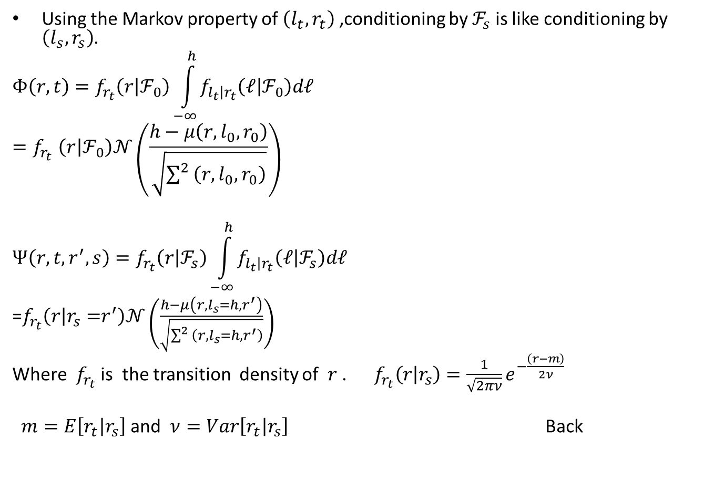
Using the Markov property of $\left(l_{t},r_{t}\right)$ ,conditioning by $ℱ_{s}$ is like conditioning by $\left(l_{s},r_{s}\right)$.
$$Φ\left(r,t\right)=f_{r_{t}}\left(r\left|ℱ_{0}\right.\right)\int_{−∞}^{h}{f_{l_{t}\left|r_{t}\right.}\left(ℓ\left|ℱ_{0}\right.\right)dℓ}$$
$${=f}_{r_{t}}\left(r\left|ℱ_{0}\right.\right)𝒩\left(\frac{h−μ\left(r,l_{0},r_{0}\right)}{\sqrt{\sum^{2}{\left(r,l_{0},r_{0}\right)}}}\right)$$
$$Ψ\left(r,t,r^{′},s\right)=f_{r_{t}}\left(r\left|ℱ_{s}\right.\right)\int_{−∞}^{h}{f_{l_{t}\left|r_{t}\right.}\left(ℓ\left|ℱ_{s}\right.\right)dℓ}$$
=$f_{r_{t}}\left(r\left|r_{s}=\right.r^{′}\right)𝒩\left(\frac{h−μ\left(r,l_{s}=h,r^{′}\right)}{\sqrt{\sum^{2}{\left(r,l_{s}=h,r^{′}\right)}}}\right)$
Where $f_{r_{t}}$ is the transition density of $r$ . $f_{r_{t}}\left(r\left|r_{s}\right.\right)=\frac{1}{\sqrt{2πν}}e^{−\frac{\left(r−m\right)}{2ν}}$
$m=E\left[r_{t}\left|r_{s}\right.\right]$ and $ν=Var\left[r_{t}\left|r_{s}\right.\right]$ Back

Slide 26
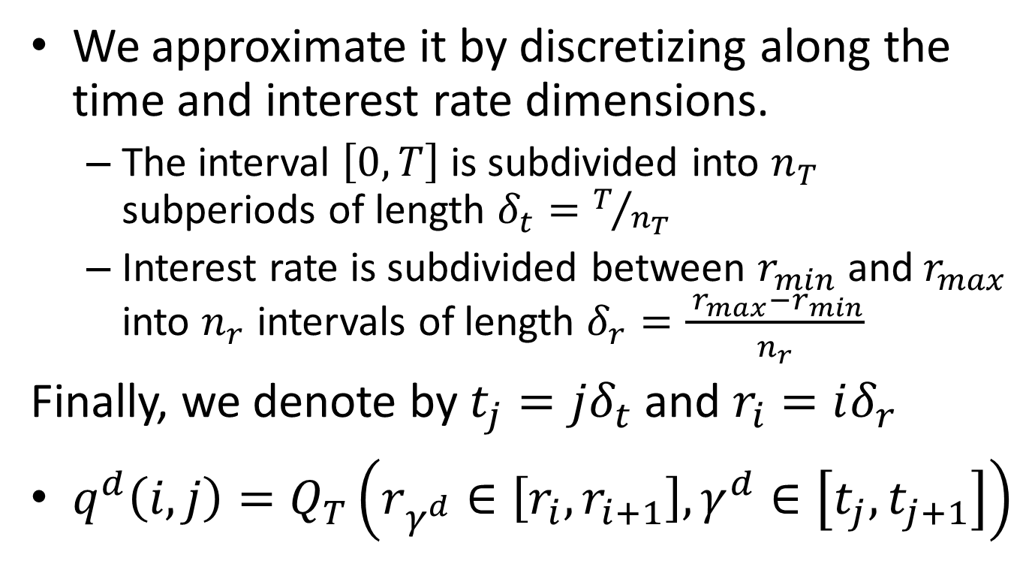
We approximate it by discretizing along the time and interest rate dimensions.
The interval $\left[0,T\right]$ is subdivided into $n_{T}$ subperiods of length $δ_{t}=T/{n_{T}}$
Interest rate is subdivided between $r_{min}$ and${ r}_{max}$ into $n_{r}$ intervals of length $δ_{r}=\frac{{ r}_{max}−r_{min}}{n_{r}}$
Finally, we denote by $t_{j}=jδ_{t}$ and $r_{i}=iδ_{r}$
$q^{d}\left(i,j\right)=Q_{T}\left(r_{γ^{d}}∈\left[r_{i},r_{i+1}\right],γ^{d}∈\left[t_{j},t_{j+1}\right]\right)$

Slide 27
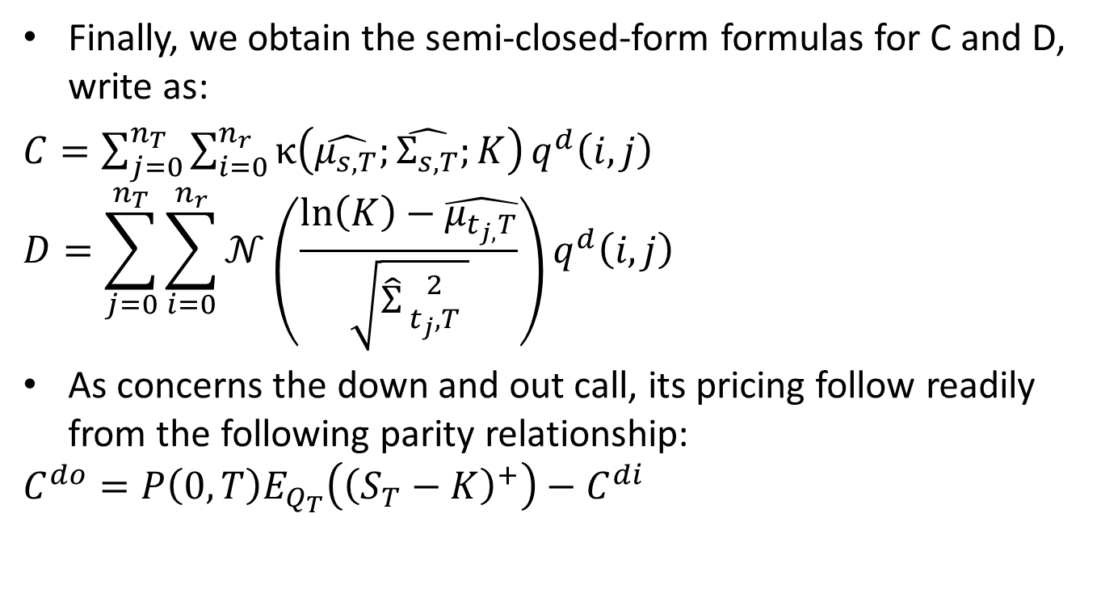
Finally, we obtain the semi-closed-form formulas for C and D, write as:
$C=\sum_{j=0}^{n_{T}}{\sum_{i=0}^{n_{r}}{κ\left(\hat{μ_{s,T}};\hat{Σ_{s,T}};K\right)}q^{d}\left(i,j\right)}$
$$D=\sum_{j=0}^{n_{T}}{\sum_{i=0}^{n_{r}}{𝒩\left(\frac{\ln\left(K\right)−\hat{μ_{t_{j,}T}}}{\sqrt{\hat{Σ}{2 \atop t_{j},T} }}\right)}}q^{d}\left(i,j\right)$$
As concerns the down and out call, its pricing follow readily from the following parity relationship:
$$C^{do}=P\left(0,T\right)E_{Q_{T}}\left({\left(S_{T}−K\right)}^{+}\right)−C^{di}$$

